Slide 1
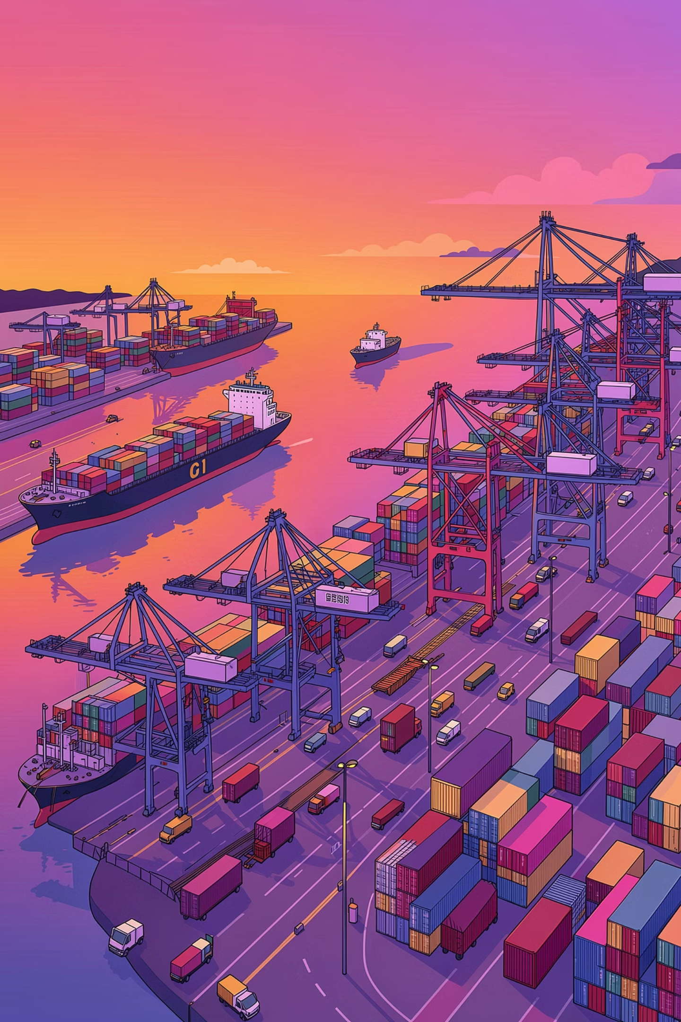
Comparative Forecasting of Global Maritime Port Traffic
Using Classical and Advanced Time Series Models
SUSHMIT KAR · BENNETT UNIVERSITY, GREATER NOIDA, INDIA

Slide 2
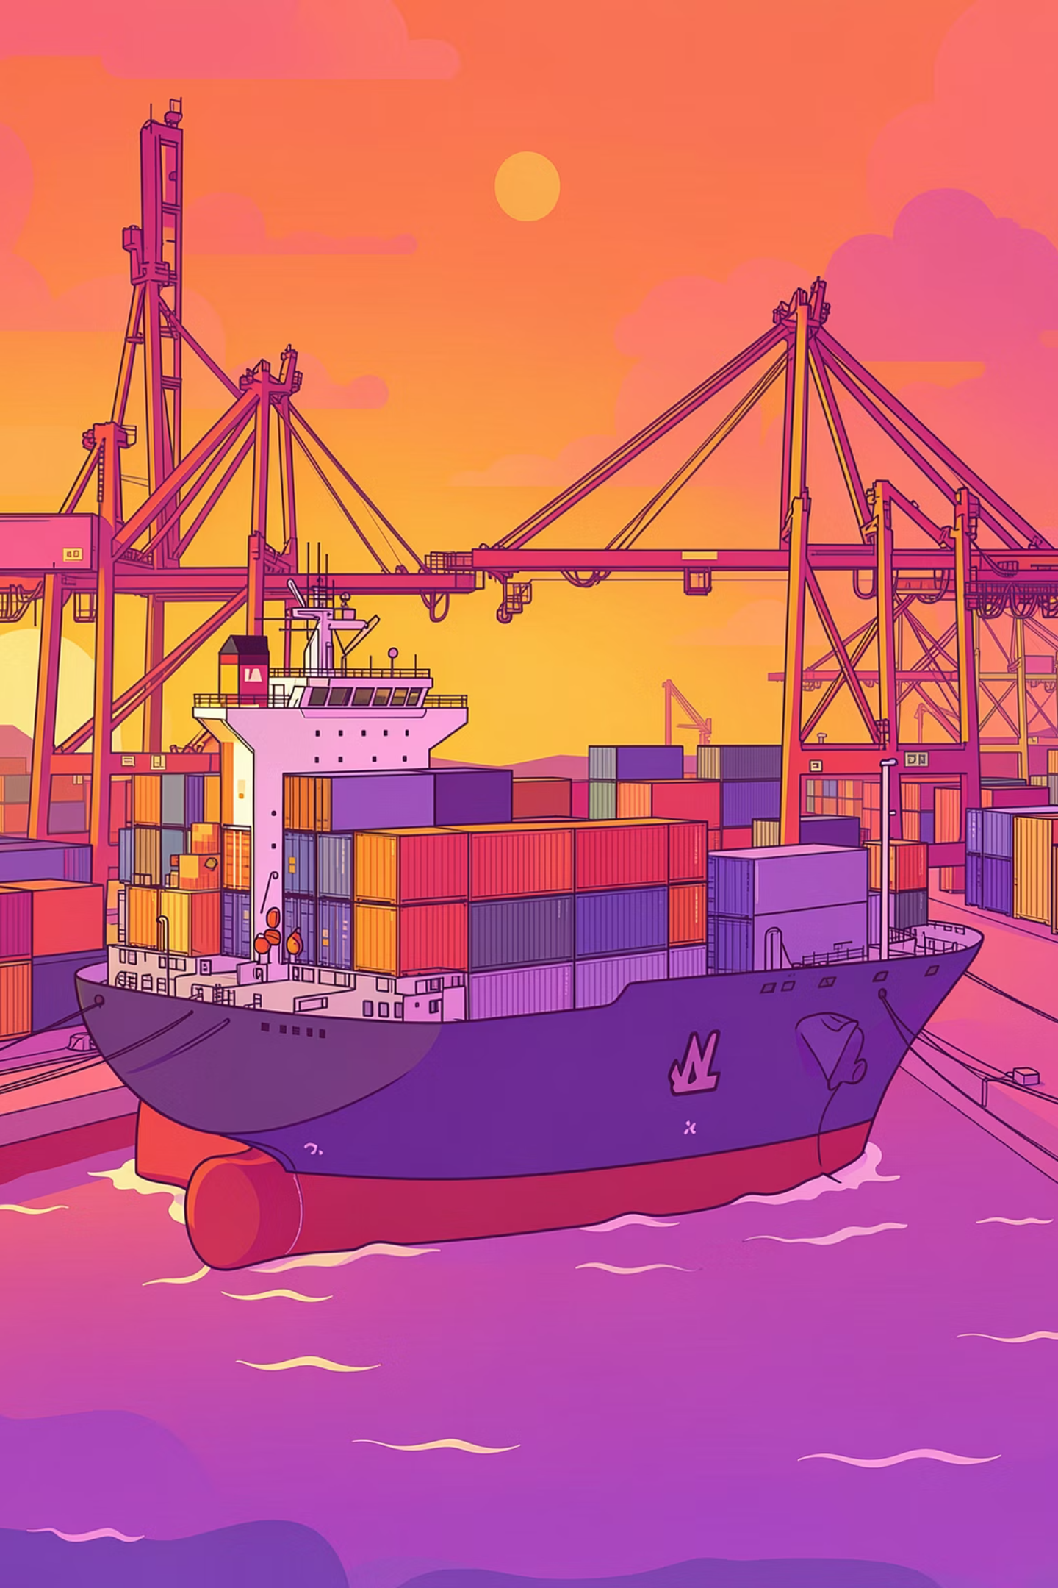
Why Port Traffic Forecasting Matters
Global seaports are critical nodes in international trade. Delays and poor planning cascade across logistics networks. Accurate short-term forecasting of vessel arrivals enables authorities to optimize operations and build supply chain resilience.
Berth Planning
Optimize dock allocation and scheduling
Workforce & Cranes
Align labor and equipment to demand
Congestion Mitigation
Preempt bottlenecks before they form
Supply Chain Resilience
Support inland transport coordination

Slide 3

Forecasting Models Under Evaluation
Five paradigms are benchmarked across 20 international ports using daily vessel call data from 2019–2026.
ARIMA
Holt-Winters
VAR
Classical autoregressive model; benchmark for linear, stationary series
Exponential smoothing for level, trend, and seasonal decomposition
Multivariate model capturing joint dependencies across regional port clusters
Prophet
XGBoost
Additive model with automatic trend shifts and multi-seasonality handling
Gradient boosting with lag features, rolling means, and calendar effects

Slide 4
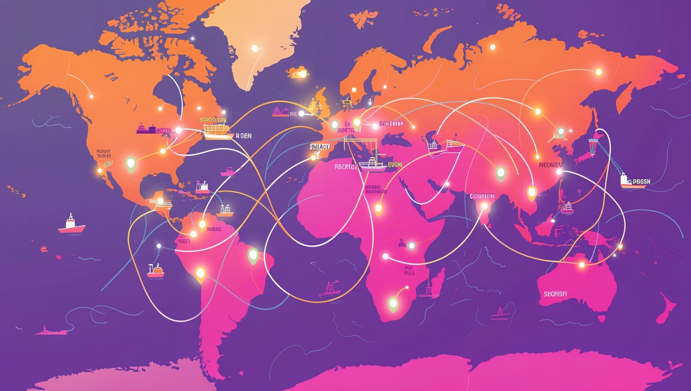
Dataset & Exploratory Findings
Ports Analyzed (2019–2026)
Singapore, Shanghai, Rotterdam, Antwerp, Busan, Hong Kong, Ningbo, Nagoya, Kobe, Yokohama, Chiba, Mizushima, Sakai-Semboku, Guangzhou, Gwangyang, Kaohsiung, Ulsan, Tianjin, Qingdao, Port Klang
Key Exploratory Insights
Singapore — highest volume, relatively stable traffic
Shanghai — higher volatility with episodic declines
Rotterdam & Antwerp — steady European patterns
Clear weekly seasonality across several ports
Anomalies linked to COVID-19, Suez blockage, and Red Sea disruptions

Slide 5

Methodology: From Raw Data to Forecasts
Feature Engineering
Model Training
Create lag-1 and lag-7, rolling means, calendar and regional leader lags.
Fit ARIMA, Holt-Winters, VAR, Prophet and XGBoost with stationarity checks.
Data Preprocessing
Evaluation
Parse dates, handle missing values, align daily series, split train-test.
Compare RMSE and MAPE across ports to select best forecasts.
Temporal order is strictly preserved in the train-test split. Stationarity checks guide ARIMA specification, while lag-based supervised features enable XGBoost to model nonlinear dependencies and disruption dynamics.

Slide 6



Evaluation Metrics
Root Mean Squared Error (RMSE)
Mean Absolute Percentage Error (MAPE)
Penalizes large prediction errors, making it sensitive to disruption-driven spikes in port traffic.
Enables scale-independent comparison across ports with vastly different traffic volumes, from Singapore to smaller Japanese industrial hubs.
Both metrics are computed on a held-out test set, preserving temporal order to reflect real-world operational forecasting conditions.

Slide 7
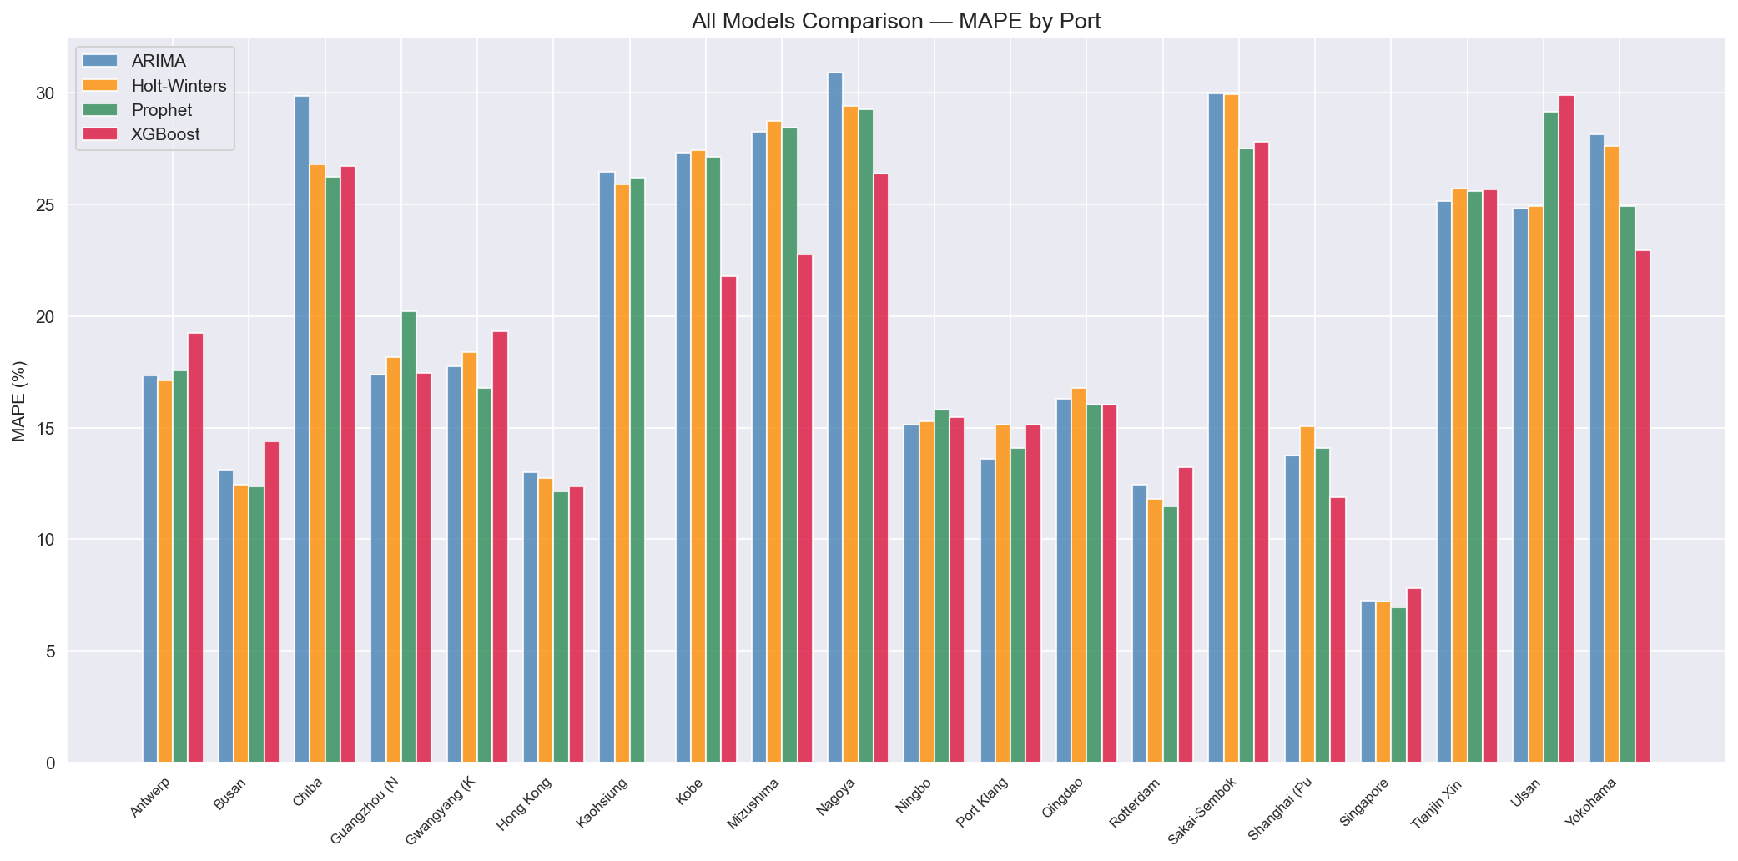

Figure 1. MAPE comparison across all ports and forecasting models. No single model dominates all ports, supporting adaptive model selection.

Slide 8
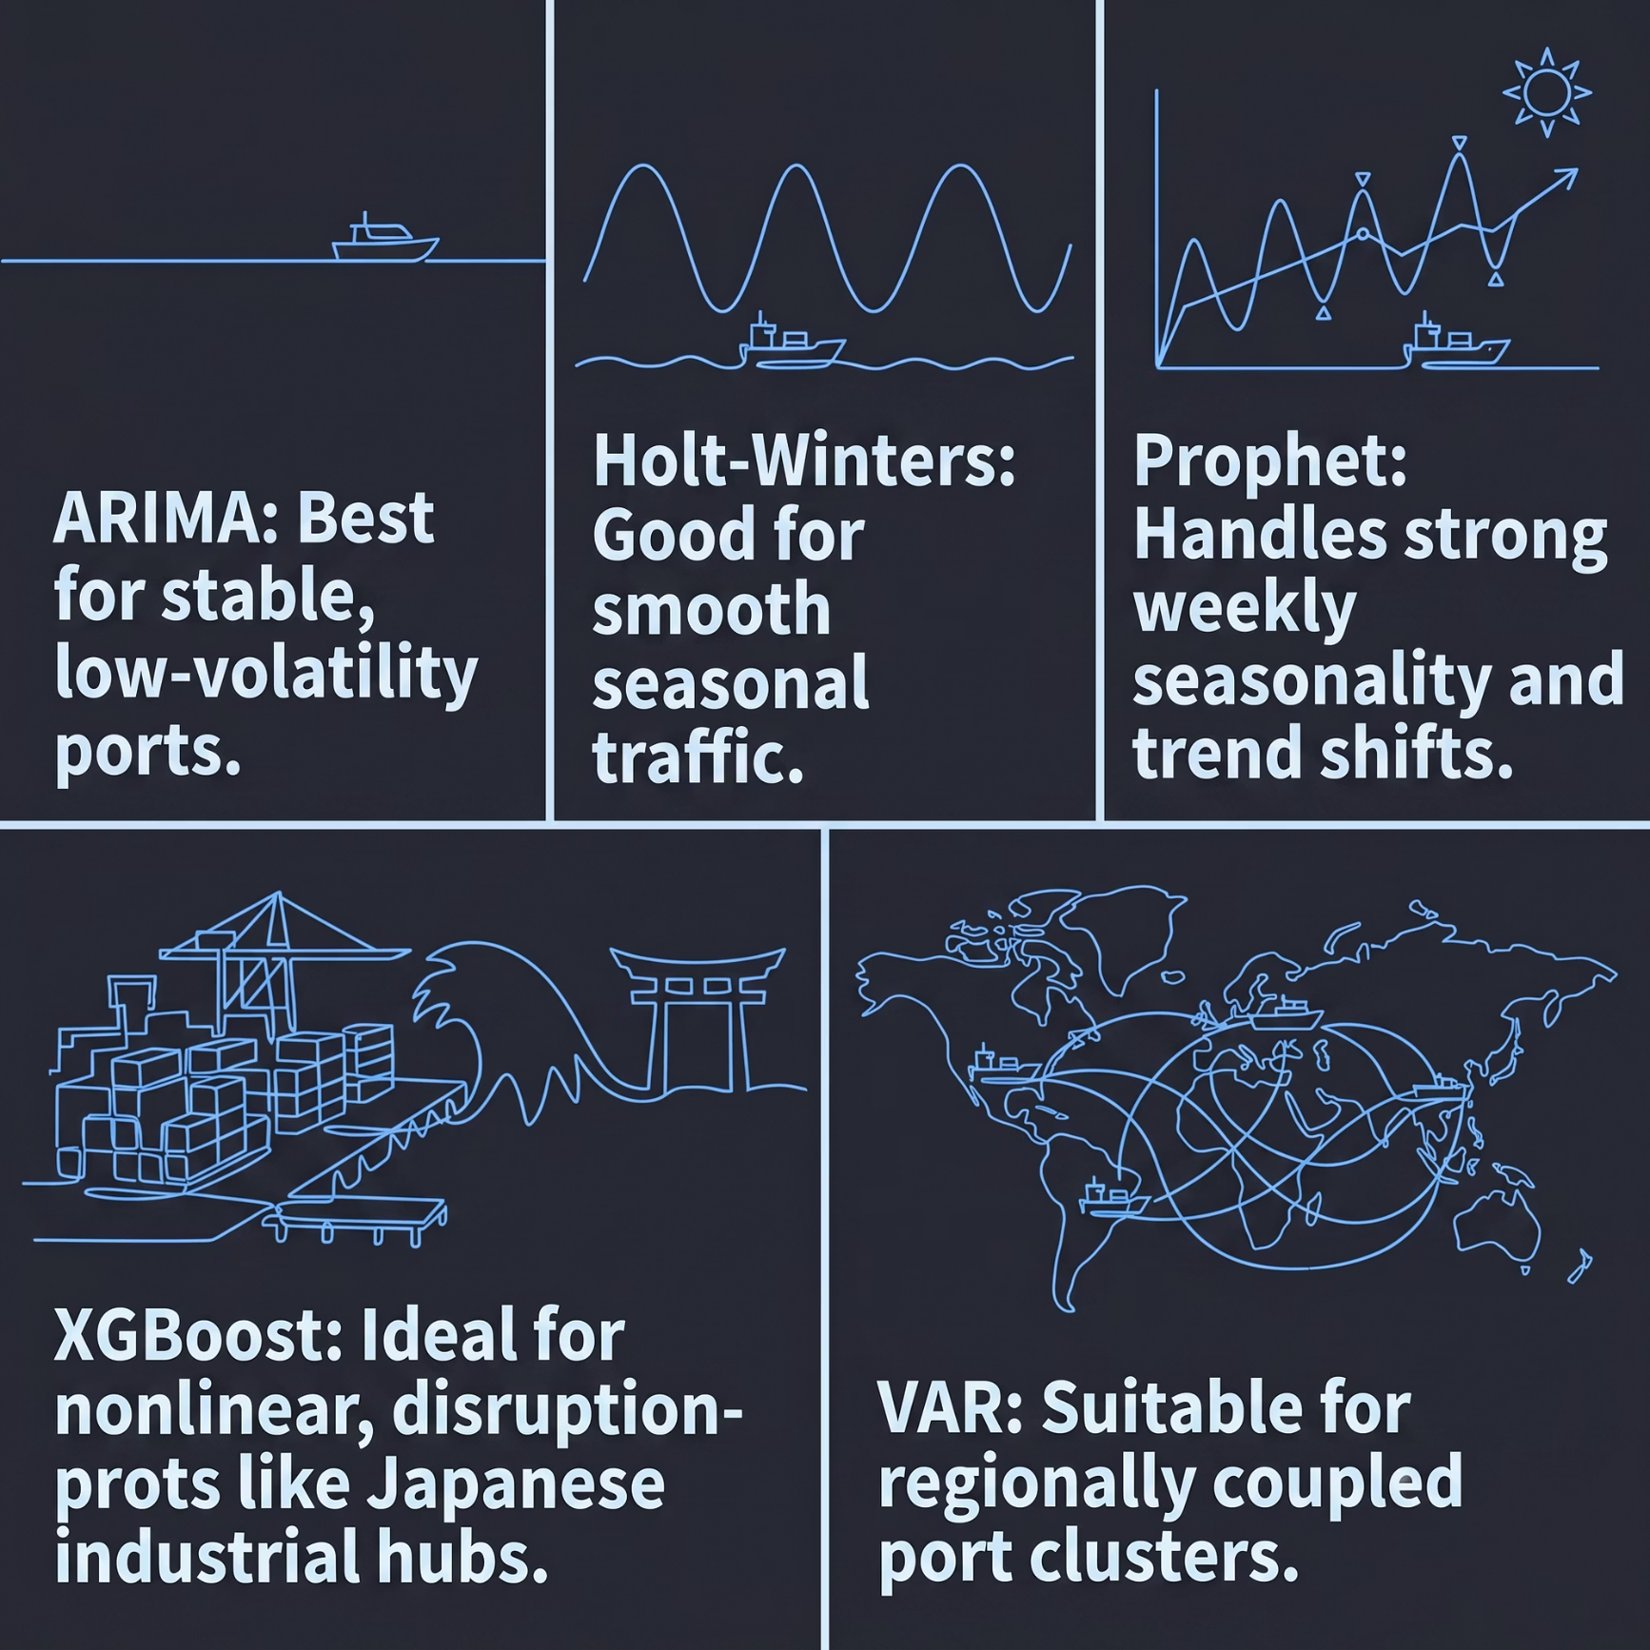

Comparative Results: No Universal Winner
Adaptive Selection Outperforms One-Size-Fits-All
Experiments confirm that no single model dominates across all ports. Port traffic dynamics differ substantially by geography and trade function.
Prophet — strong results across seasonal ports
XGBoost — superior on volatile Japanese industrial ports
ARIMA — competitive on smoother, stable series
Holt-Winters — reliable but less adaptive to abrupt shocks
VAR — minimal gains , confirms weak co-movement but not disruption propagation

Slide 9
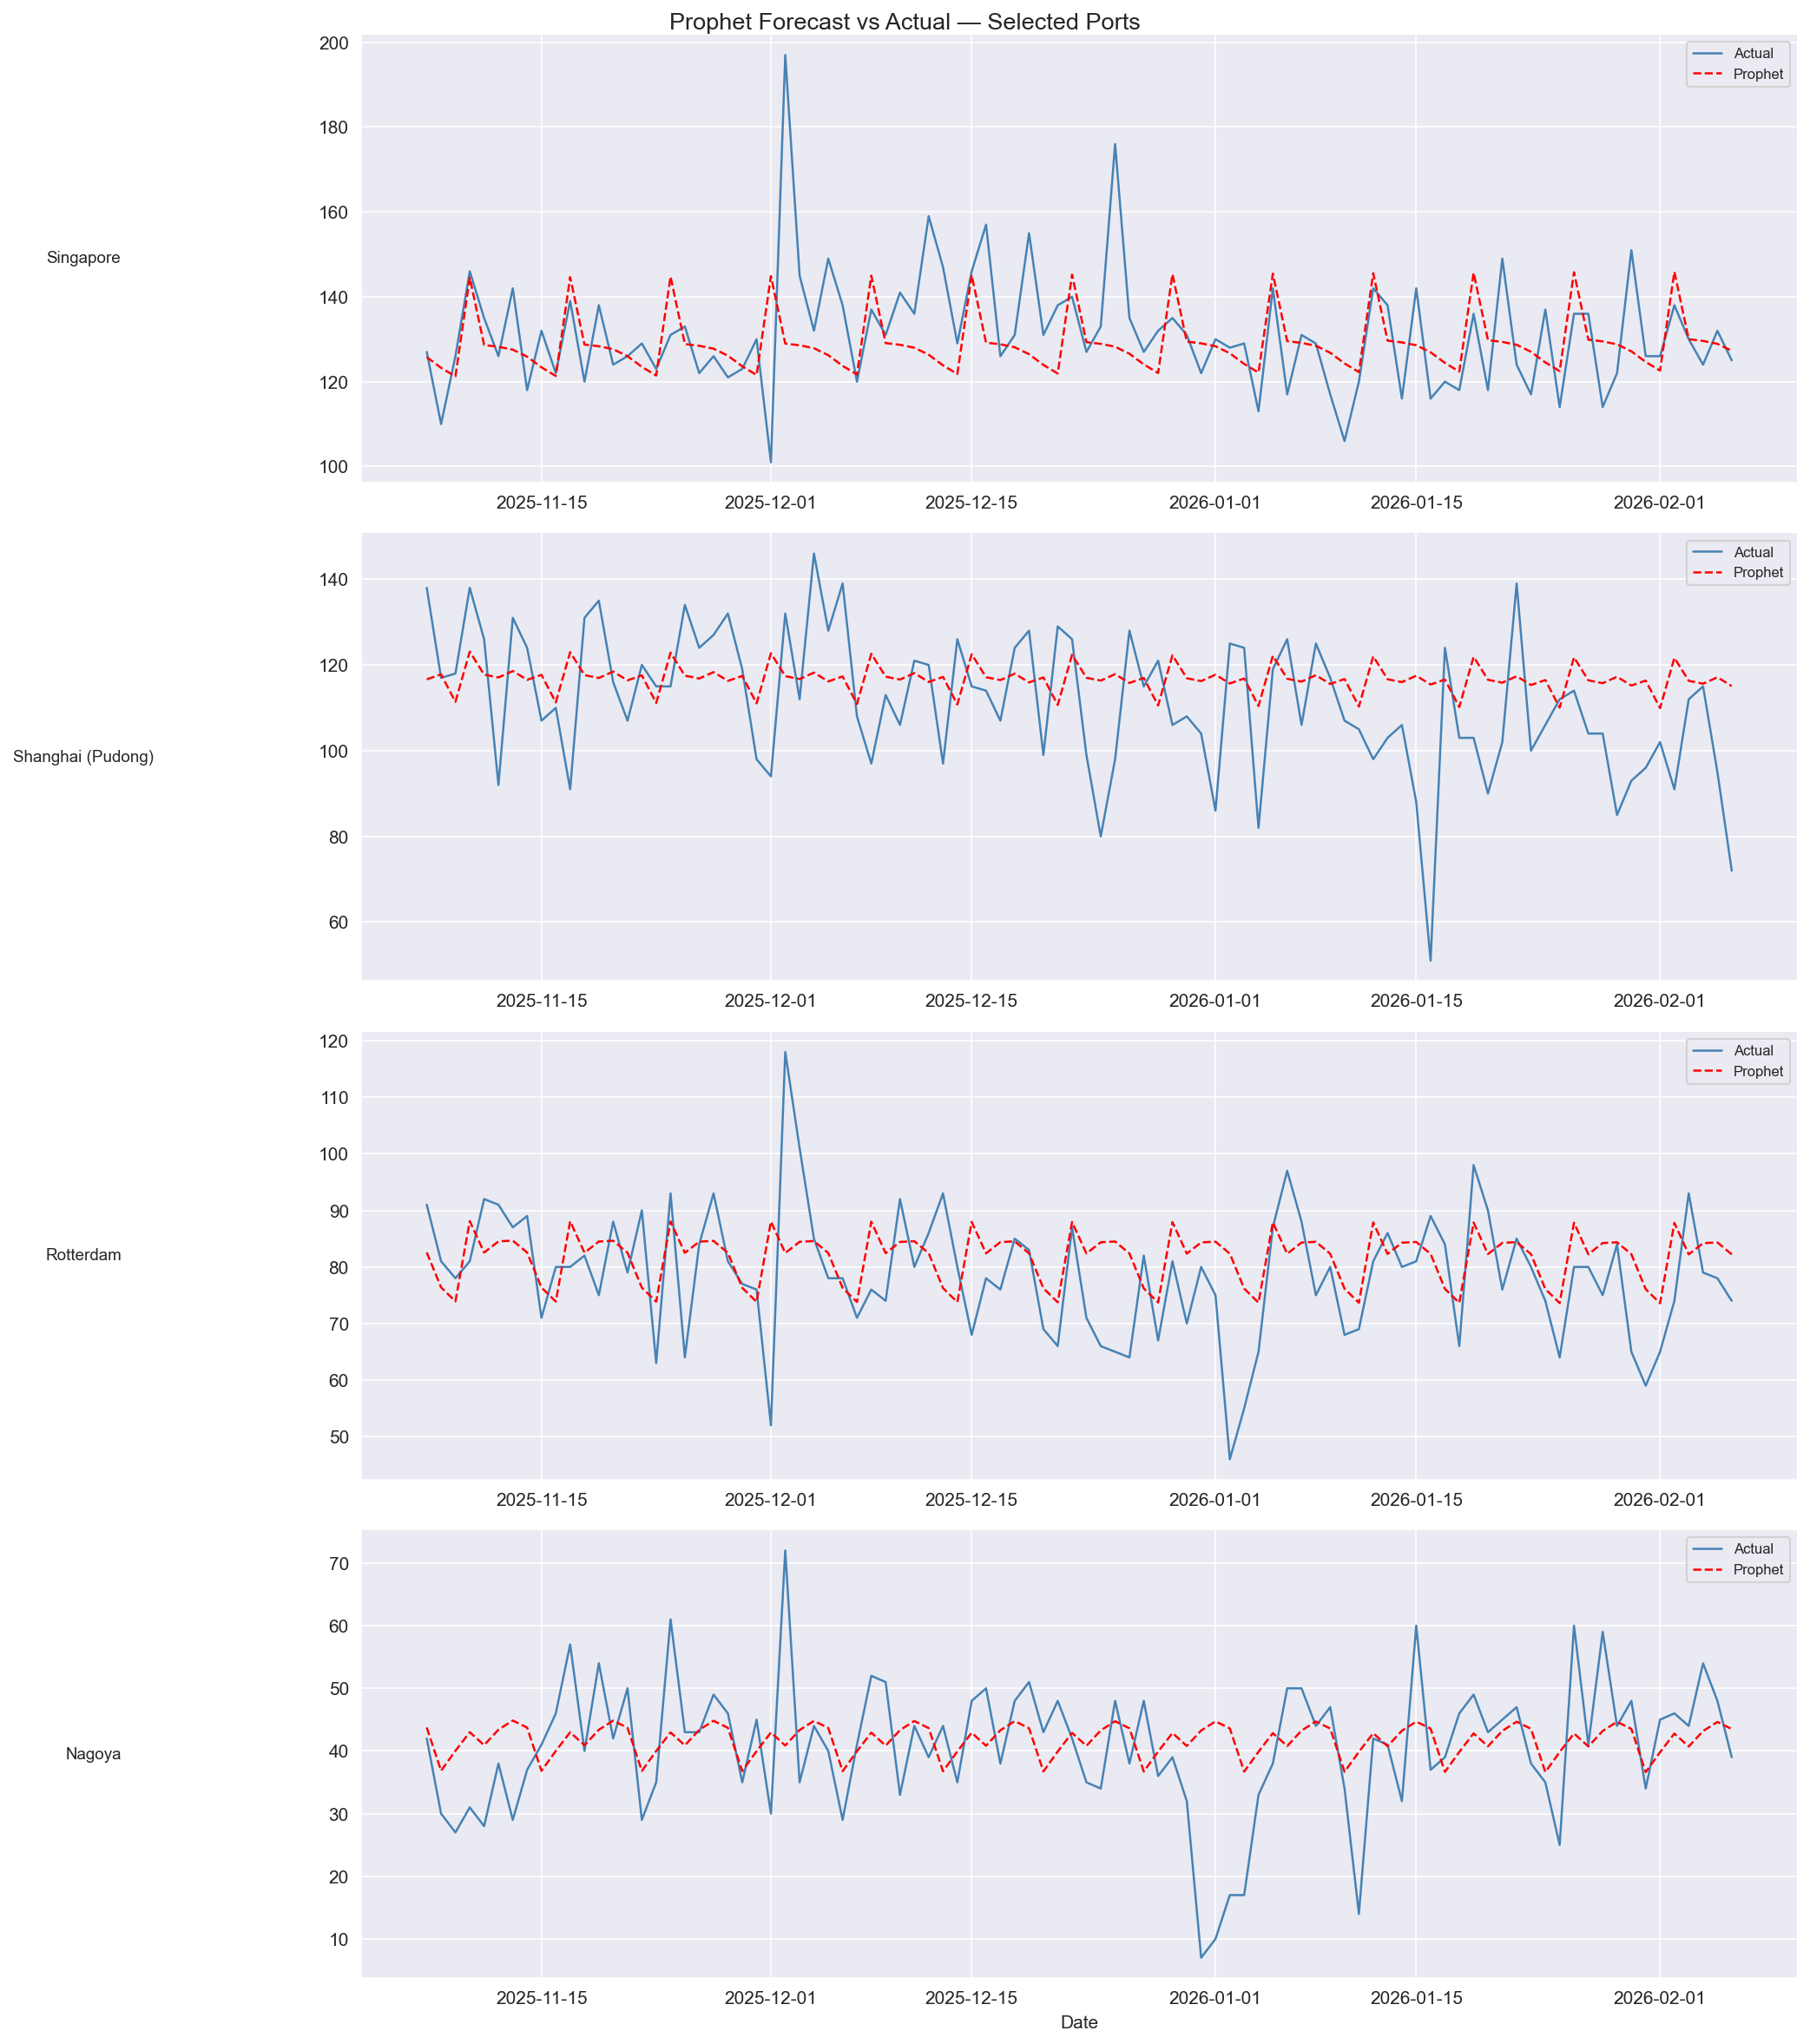
Figure 2. Forecast vs actual vessel calls for selected ports. Models perform differently across seasonal, stable, and volatile traffic patterns.

Slide 10

Port Disruption Contagion — The Central Finding
The Main Question
Does disruption at one major port propagate to neighbouring ports, and can this signal be measured and predicted?
The Answer
Cross-Correlation: 262 statistically significant port pairs found across lags 1–14 days. All top pairs concentrated in one Japanese cluster — disruption spreads regionally, not globally.
Granger Causality: Yokohama's history significantly predicts Nagoya's future (p < 0.001) at lags 1, 2 and 3 — confirming the signal is directional, not coincidental.
XGBoost Feature Importance: leader_lag1 ranked as the single most important feature across all 6 cluster ports — outweighing each port's own recent history.

Slide 11
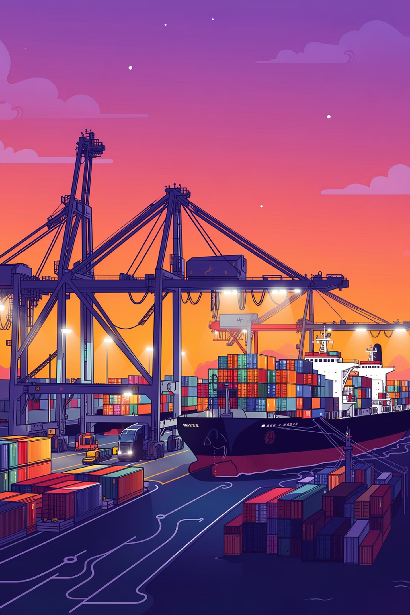




Real-World Applications
Berth Allocation
Pre-schedule dock assignments based on predicted vessel arrivals
Workforce Planning
Deploy cranes and labor aligned to forecasted demand peaks
Yard Capacity
Pre-position containers and manage storage before surges
Disruption Early Warning
Flag anomalies during geopolitical or weather-driven events

Slide 12
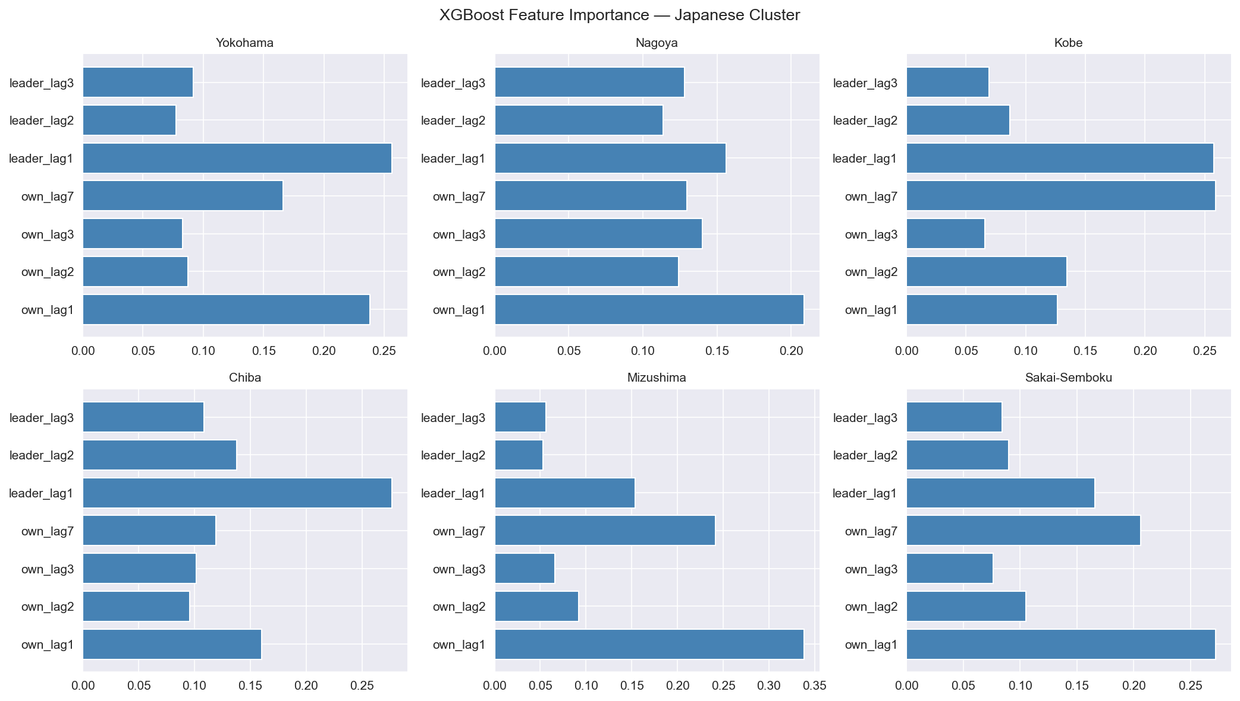

Figure 3. XGBoost feature importance for Japanese cluster ports. Recent traffic (lag-1), weekly lag (lag-7), and leader-port signals were most predictive.

Slide 13

Limitations of This Study
No Exogenous Drivers
Weather, fuel prices, and macroeconomic indicators were not incorporated as external regressors.
Geopolitical Unpredictability
Sudden disruptions (e.g., Red Sea conflict) remain inherently difficult to forecast.
Deep Learning Scope
LSTM, GRU, and Transformer models were not extensively tuned in this study.
Long-Horizon Forecasting
Extended prediction windows and highly noisy operational ports were outside the present scope.

Slide 14





Conclusion & Future Directions
This study demonstrates that adaptive model selection — not a universal strategy — is essential for accurate maritime port traffic forecasting. ARIMA, Prophet, and XGBoost each excel under distinct operational conditions.
Deep Learning Benchmarks
Exogenous Regressors
LSTM, GRU, and Transformer architectures for temporal modeling
Weather, fuel prices, and macroeconomic indicators as model inputs
Real-Time AIS Integration
Ensemble Systems
Live vessel stream data for operational forecasting pipelines
Hybrid pipelines combining statistical and ML model strengths
Key Takeaway: Hybrid forecasting pipelines that select models by port profile can significantly improve maritime decision-making under uncertain global trade conditions.

